Slide 1
Monetization
The right business model for your digital assets
Bryan Kirschner
Anita Paul
Apigee
@apigee
Notes:
Creative Commons Attribution-Share Alike 3.0 United States License

Slide 2


Anita Paul
Bryan Kirschner

Slide 3
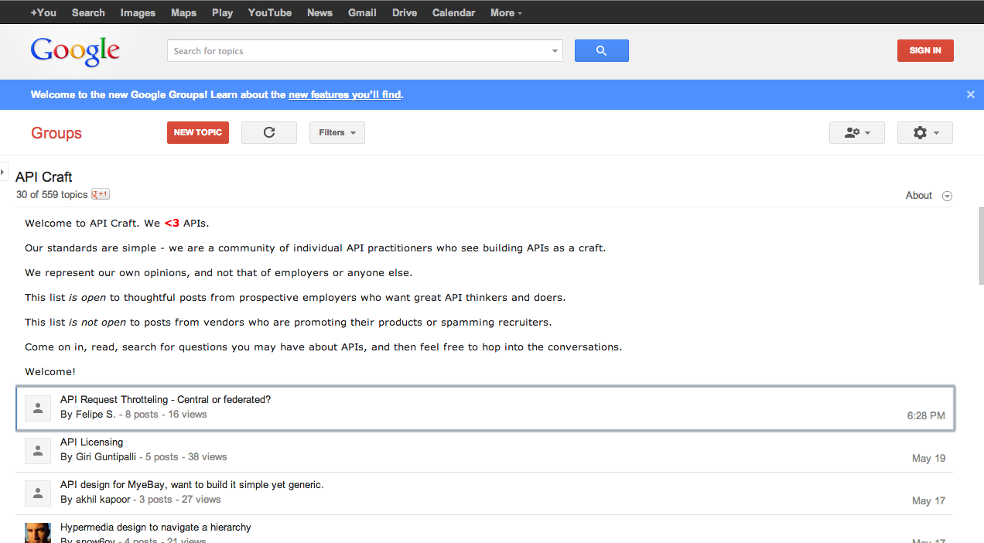
groups.google.com/group/api-craft

Slide 4
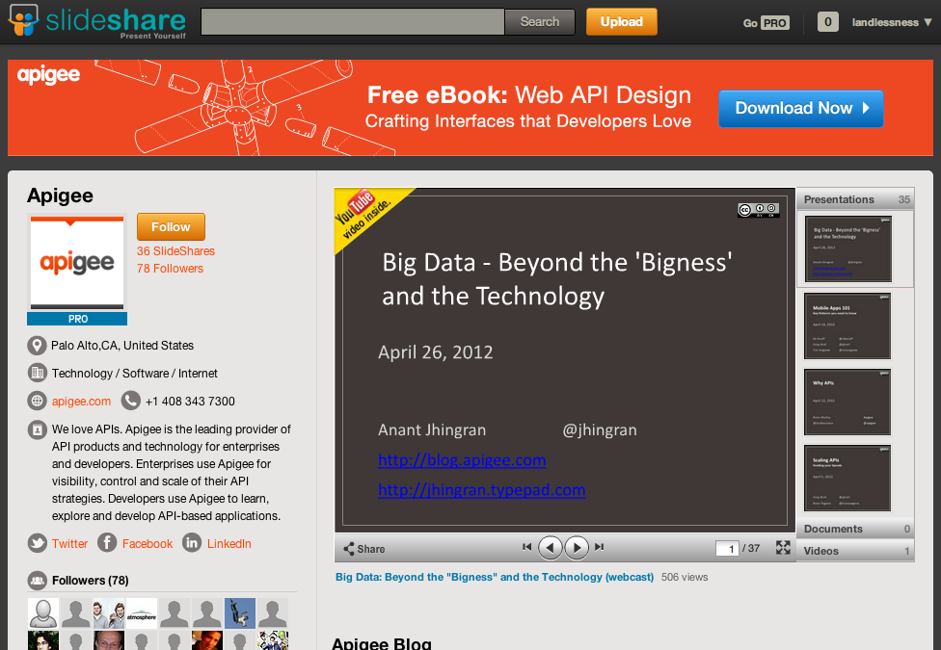
slideshare.net/apigee

Slide 5

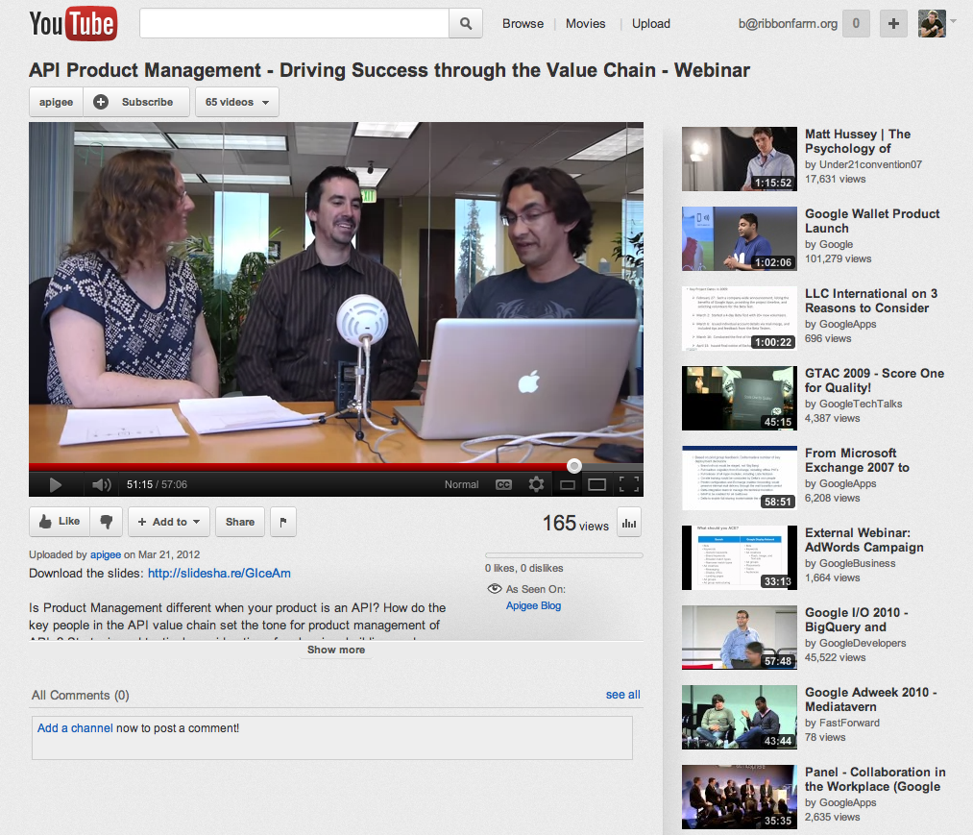
youtube.com/apigee
Notes:
This video and other videos of the webcast series will be available on youtube
At youtube.com/apigee

Slide 6

Join us at the I APIs conference!

Slide 7
Every company has a digital asset opportunity.
Digital assets have real-world value to yours.
The right tools can change the game for you.

Slide 8
Every company has a
digital asset opportunity…

Slide 9
Some have embraced digital faster than others
Average score deploying apps, using data analytics, and operating APIs today:
23.8 out of 30
Average score deploying apps, using data analytics, and operating APIs today:
14.4 out of 30
Survey of executives in 200 large companies across 40 industries, May 2013.
Notes:
We divided 200 big companies companies into two groups based on their current performance on three digital capabilities (totals are slightly off from 50/50 due to tie scores)

Slide 10
And the Digital Competitors dominate . . .
Strong Outperformance In Last 12 Months
Maximum Confidence in
Competitive Trajectory
Expected High
Impact from Digital
…on margin, revenue, share, satisfaction, or delivering new products & services
…high confidence in much stronger competitive position 5 years from now
…big impact over
next 12 months and increasing a great deal over next 5 years

Slide 11
Why?

Slide 12

Because they use apps,
APIs and analytics to turn
digital assets
into dollars
65% of executives say digital business will increase operating income in next 3 years
- McKinsey & Company, McKinsey Global Survey August 2013
Notes:
Because they have connected digital assets to real dollars…
http://www.gettyimages.com/detail/illustration/binary-codes-on-us-currency-symbol-royalty-free-illustration/AA028347

Slide 13
How?

Slide 14
Proprietary data
Digital real estate
Digitized processes
The digital ecosystem
Notes:
Proprietary data
Digital real estate
Digitized processes
Digital ecosystem

Slide 15


Like those who sell their proprietary digital data
Experian can sell their different data offers at different prices.
Google Maps charges developers via their API depending on volume.
Notes:
integrated set of services for app creation, enterprise api design and operations, developer collaboration, and end to end visibility into the digital value chain

Slide 16

Or those who charge for advertising access to their platforms
Facebook uses APIs to charge advertisers per click or per action on their app.
Anyone with an app, or digital platform can do the same thing.

Slide 17




Those who increase their reach by paying others to sell
Thousands of companies can use monetized APIs to extend their reach through affiliates.
Some use monetized APIs to pay affiliates different amounts depending on the item that’s sold.

Slide 18



And those who share revenue on a sale
Monetized APIs can help financial platforms distribute money to all interested parties.

Slide 19
Digital assets can have real value to your business…

Slide 20
“We don’t have digital assets”
“We can’t see a way to monetize them”
“It’s too hard”

Slide 21
“We don’t have digital assets”
The number of connected devices-from smartphones to smart cars and even wearable computing devices-is heading for a tipping point at which most work, play, and commerce will have a digital dimension. As a result, software will touch nearly all social interactions or commercial transactions, with the potential to generate data of unprecedented scope
Mastering a fast feedback loop will be a key differentiator. Companies that quickly deliver digitally instrumented products or services, harvest data from market interactions, and use insights to rapidly iterate and optimize their value chain will gain competitive advantage that continuously builds on itself.
Relevance to competitive position over next five years among Digital Competitors

Slide 22


“We don’t have digital assets”
Notes:
Need to clear rights on an image

Slide 23
Revenue models for monetization
We can’t see a way to monetize digital assets
You Pay Developer –
Affiliate/Payment Processing
Developer Pays –
Advertising/Data/Search/Cloud (storage/mgd services)
Digital Assets
Revenue Sharing
Fees
Charging
Fixed Revenue Share
One off
Transaction volume
Flexible Revenue Share
Recurring
Custom attribute
Revenue share by type of content
Flat rate
Volume banded
Bundled
Notes:
These are the revenue models needed for API monetization
But the lack of flexibility of the back end systems means a combination of marketing, plus manual processes, plus length and costly IT projects, in order to manage these models

Slide 24
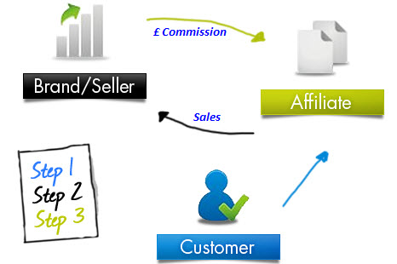
Monetization Opportunity 1
(Revenue Sharing)
Expose your catalog (with your APIs) to partners to sell & advertise your content on their website & apps
Why?
To reduce overheads (reduction in physical branches and sales force) and increase sales through partners
Notes:
The % can be fixed for all types of content (fixed revenue share), or varied depending on type of content (custom attribute), or varied on total sales generated over a period (flexible revenue share)
Example Businesses – Online retailers, travel/hospitality, software, shared services

Slide 25
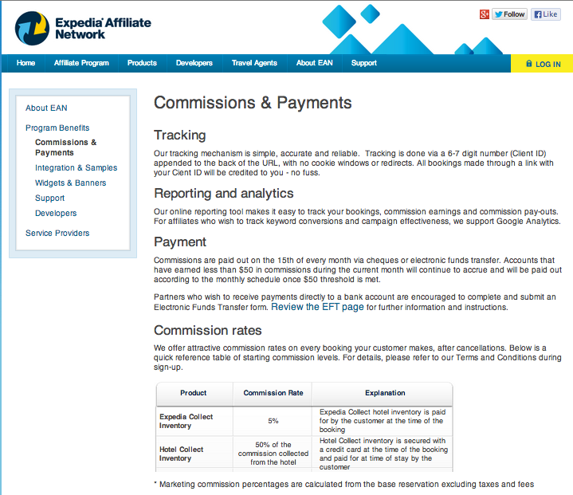
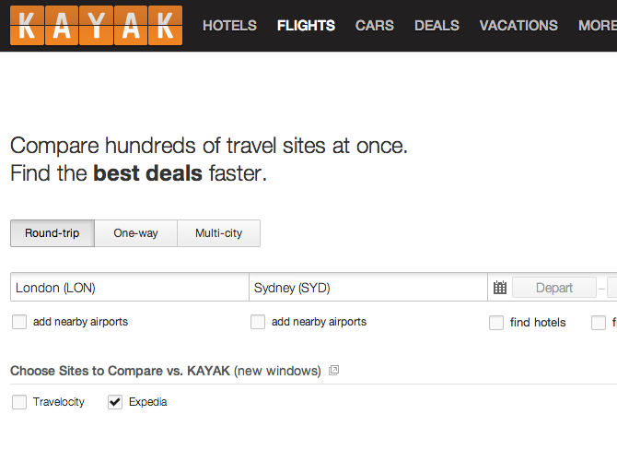
Example
Notes:
The % can be fixed for all types of content (fixed revenue share), or varied depending on type of content (custom attribute), or varied on total sales generated over a period (flexible revenue share)
Example Businesses – Online retailers, travel/hospitality, software, shared services

Slide 26
Monetization Opportunity 2: Payment Processing APIs
(Revenue Sharing and Rate Card)
Offer an API to merchants/partners to charge your subscribers for their content
The charge could be direct to “mobile” bill, or to credit card/debit cards and other payment instruments
Why?
To take advantage of the online payment revolution and the mobile wallet
Notes:
The revenue share can be a fixed % of the total charge to the subscriber for each transaction, variable % based on cumulative revenue generated across transactions, variable based on the price of the transaction, variable based on the type of content sold.
The revenue share share plan can also have a “fee” element, for example % revenue share to developer less x fee to the API provider per transaction.
You collect the money from your subscribers and pass this on to your partners after deducting your fees/rev share
Example businesses – Online payment processors, mobile operators

Slide 27
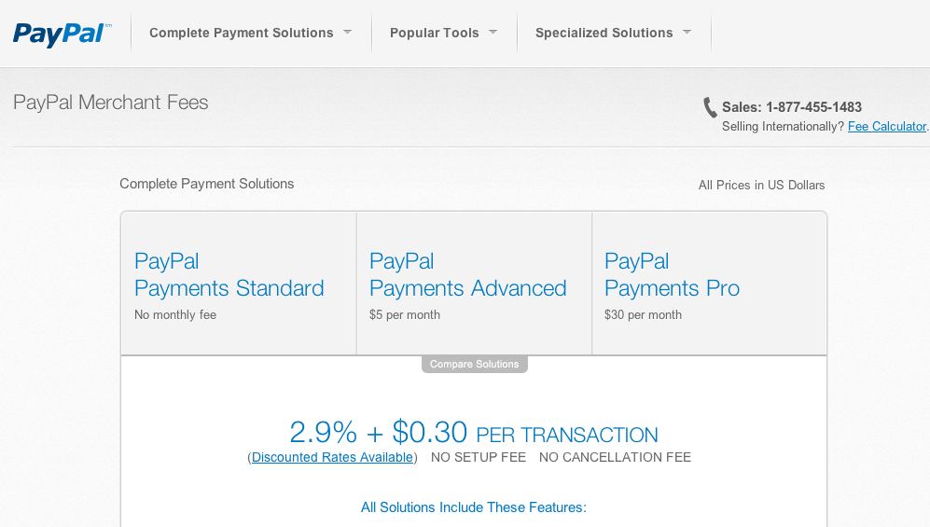
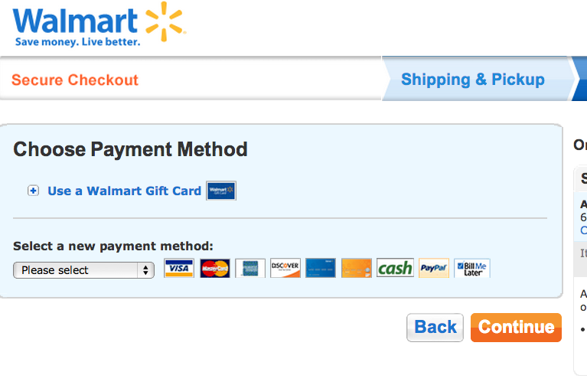
Example
Notes:
The revenue share can be a fixed % of the total charge to the subscriber for each transaction, variable % based on cumulative revenue generated across transactions, variable based on the price of the transaction, variable based on the type of content sold.
The revenue share share plan can also have a “fee” element, for example % revenue share to developer less x fee to the API provider per transaction.
You collect the money from your subscribers and pass this on to your partners after deducting your fees/rev share
Example businesses – Online payment processors, mobile operators

Slide 28
Monetization Opportunity 3: Advertising APIs CPC or CPA
(Developer Pays)
Expose APIs to partners to advertise their content on your website or app
Why?
To generate additional revenue as a result of your target audience for your website/mobile apps
Notes:
The rate can be a fixed rate, varied depending on volume (volume banded), purchased in blocks up front (bundled), varied by type of action (custom attribute)
Charge partners based a rate per click (CPC) or a rate per action (CPA)
Example Businesses – social network sites, major retailers, travel

Slide 29
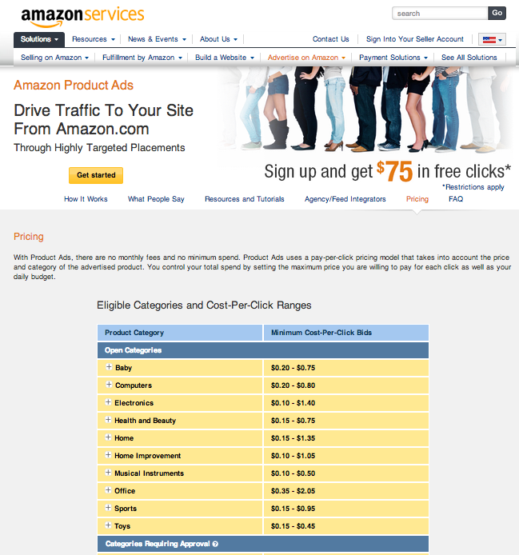
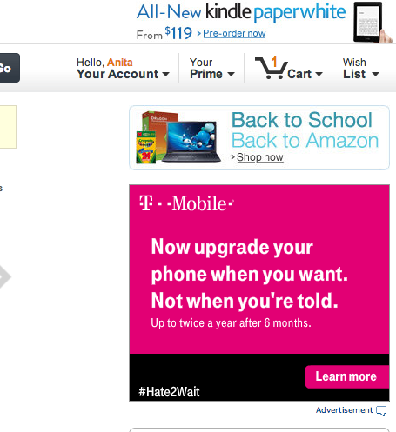
Example

Slide 30
Monetization Opportunity 4: Search/Data APIs
(Developer Pays)
Expose APIs to your partners to search for (and retrieve) information (based on your knowledge database)
Why?
To generate additional revenue from your proprietary data
Notes:
The charge can be varied depending on the type of information returned (separate APIs for retrieving different types of information, or custom attribute based rating), the volume of searches made (volume banded), or charged up front for bundles of searches (bundled)
Charge for type or quantity of data returned per API call
Example Businesses – Financial Services, search engines, major retailers, social network sites (anyone with unique/valuable consumer data!)

Slide 31
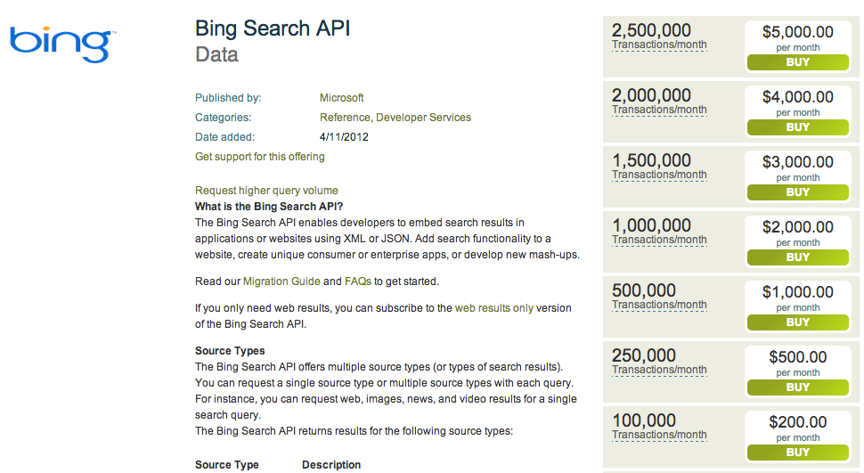
Example

Slide 32

But…
http://gapingvoid.com
Notes:
We knew how we could gain revenue
But…
Marketing / IT gap
Inefficient
Inflexible
Unpleasant

Slide 33
The right tools can
change the game for you…

Slide 34
Revenue models for monetization
You Pay Developer –
Affiliate/Payment Processing
Developer Pays –
Advertising/Data/Search/Cloud (storage/mgd services)
Digital Assets
Revenue Sharing
Fees
Charging
Fixed Revenue Share
One off
Transaction volume
Flexible Revenue Share
Recurring
Custom attribute
Revenue share by type of content
Flat rate
Volume banded
Bundled
Marketing
Complex, Manual & Ad Hoc Processes
IT
Backend Financial Systems
Notes:
These are the revenue models needed for API monetization
But the lack of flexibility of the back end systems means a combination of marketing, plus manual processes, plus length and costly IT projects, in order to manage these models

Slide 35
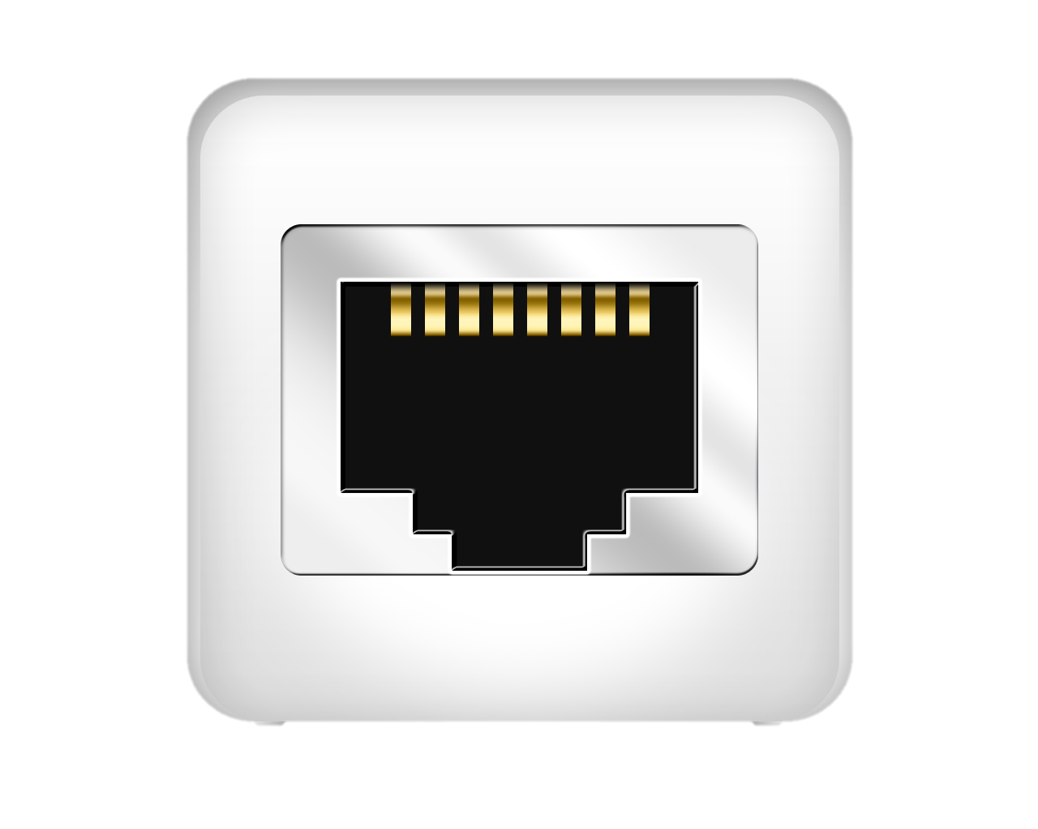
Monetization Services plugs you in
You get real time, direct, monitoring of performance and proactive reaction
Your partners/customers can get real time reporting and response, increasing their satisfaction
All with seamless integration to existing back end systems

Slide 36
Revenue models for monetization
You Pay Developer –
Affiliate/Payment Processing
Developer Pays –
Advertising/Data/Search/Cloud (storage/mgd services)
Digital Assets
Revenue Sharing
Fees
Charging
Fixed Revenue Share
One off
Transaction volume
Flexible Revenue Share
Recurring
Custom attribute
Revenue share by type of content
Flat rate
Volume banded
Bundled
Apigee Monetization Services
Backend Financial Systems
Notes:
Monetization Services covers them all in a simple and flexible way and integrates seamlessly with your back end financial systems

Slide 37
Monetization Services: functionality overview
Business
Business Profile
Developer Category/ Billing Type Management
Catalog & Plan Configuration
Prepaid integration
Billing, Revenue & Reports
Adjustments, Billing Docs
Limits/ Notifications
Developer/Partner
Developer Profile
User Role Management
Purchased
Plan
Prepaid Balance Management
Billings & Revenue Reports
Received Billing Docs
Notifications
Notes:
Monetization Services keeps you plugged in:
- realtime monitoring of performance and proactive reaction
- realtime reporting and response to your partners/customers to keep them satisfied
- seamless integration with back end systems to minimise disruption of existing processes

Slide 38
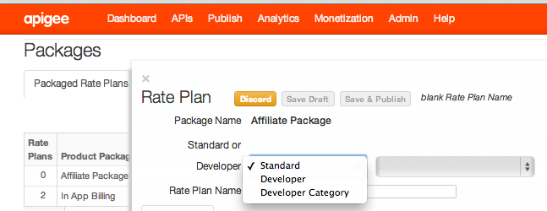
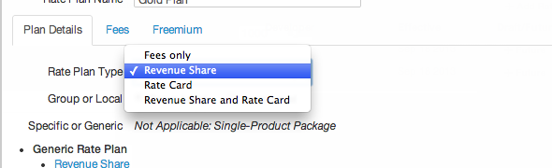
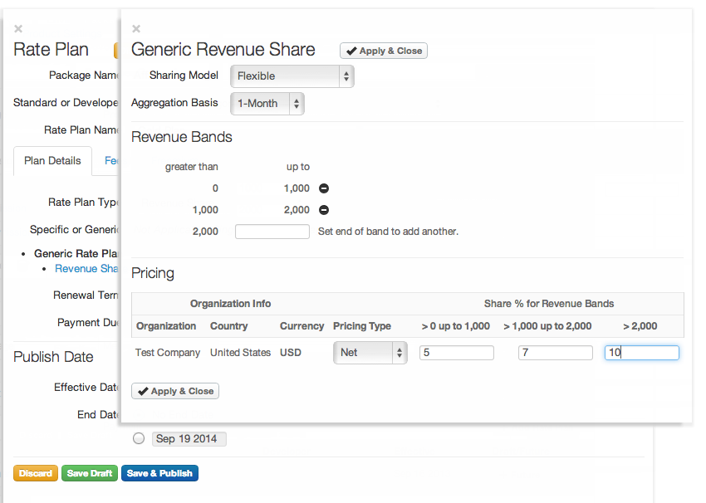
Set flexible plans . . .
Notes:
Pick who you want to set the plan for
Select the type of plan you want
Set your plan and publish

Slide 39
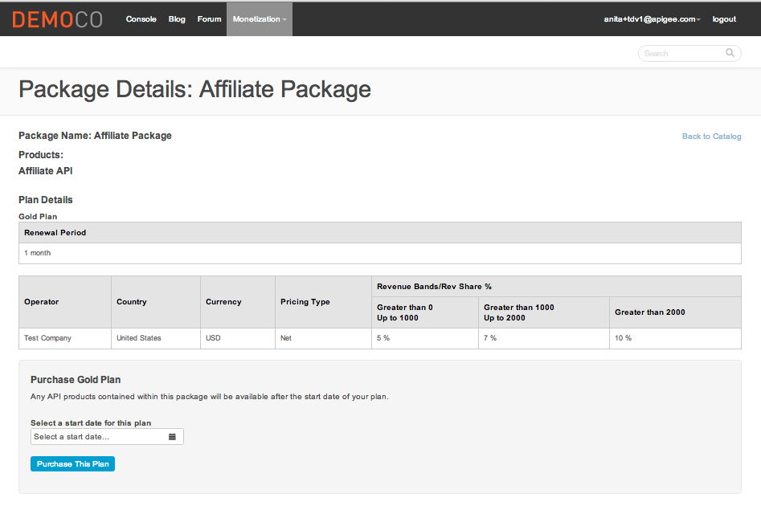
Automatically publish them to Developer Portal(s)

Slide 40
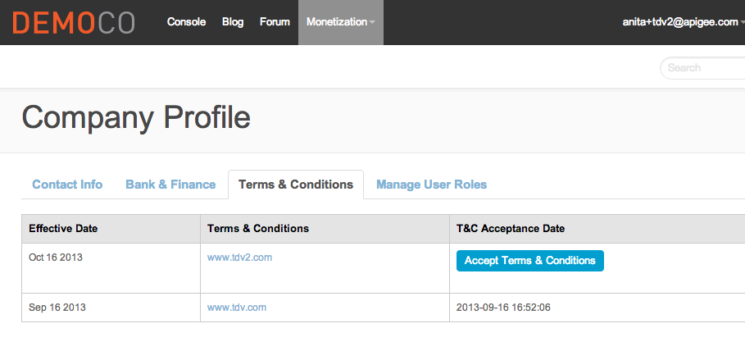
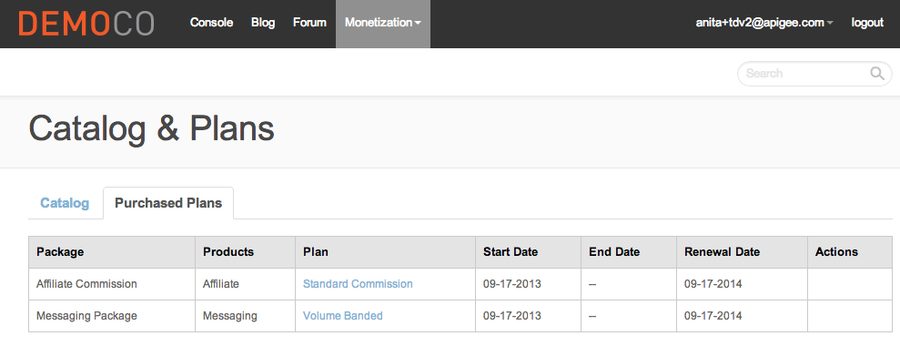
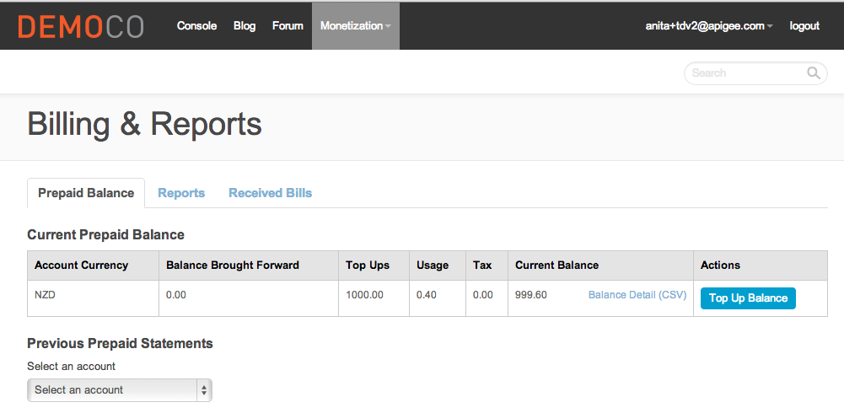
Self service for partners
Notes:
Minimise overhead by allowing self service for your partners and removing manual processes both for your team and your partners’ teams.
Faster time to market
Lower cost + automation = less risk

Slide 41
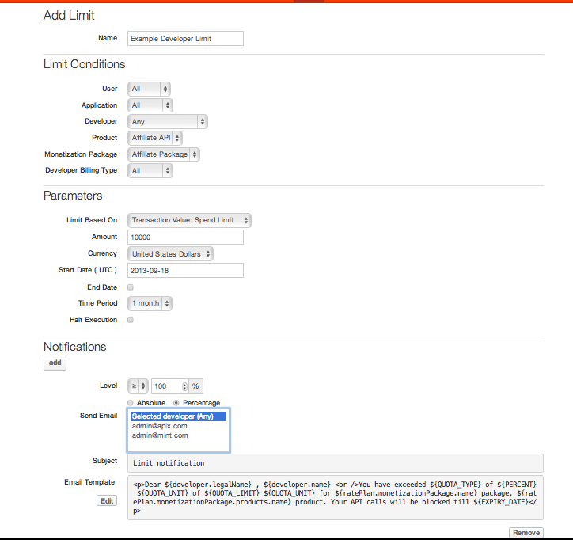
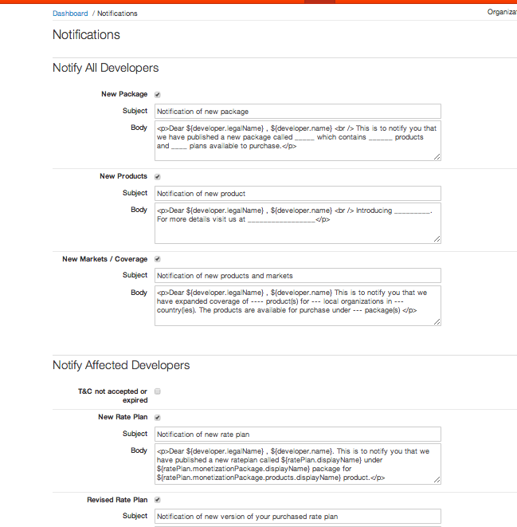
Limits, notifications, and monitoring
Notes:
Reacting proactively
Setting limits and thresholds and notifications for when they’ve been reached or are being reached
Setting notifications for other events to help you manage the process
Real time detailed reporting to allow you to analyse the results and react accordingly

Slide 42
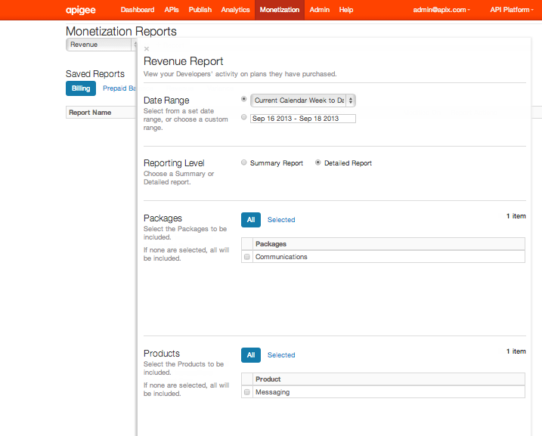
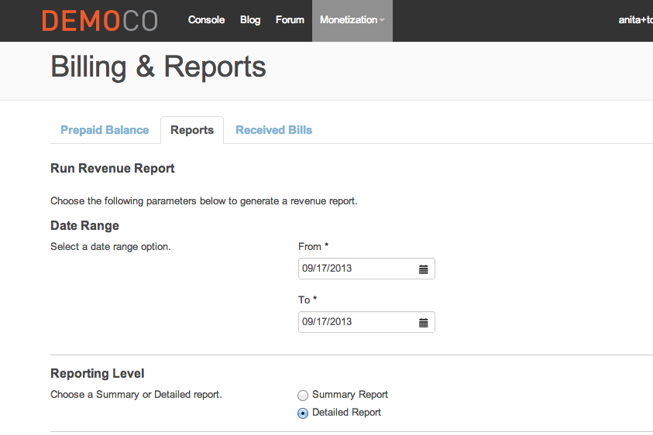
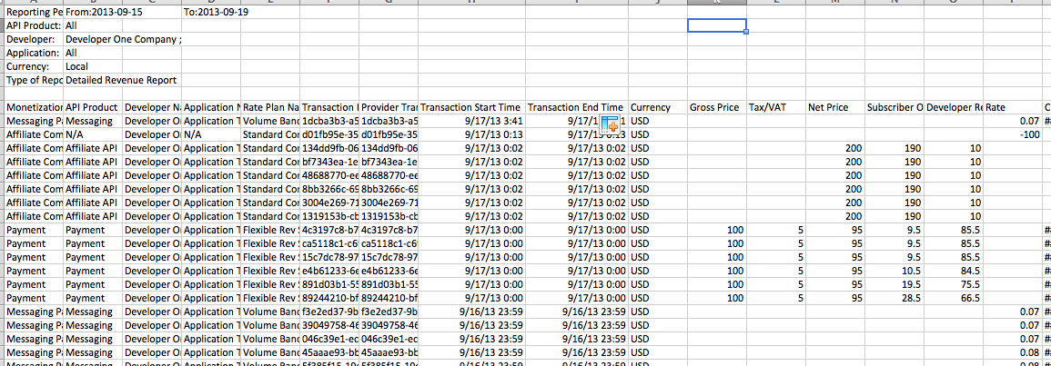
Real-time reporting for the business and partners

Slide 43
Monetization delivers on
Alignment btwn marketing and IT
Efficiency
ROV
And can change the game for you & make you a digital landlord…
Here’s how…
Recap . . .

Slide 44
Now is the time to . . .
Uncover the digital assets at your company.
Unlock their real-world value across every audience.
Get the tools to build business models around your digital assets.
…join the “digital landlords” emerging in every industry

Slide 45
Questions?
Anita Paul
Bryan Kirschner

Slide 46
Join us at the I APIs conference!

Slide 47
THANK YOU
Subscribe to webcasts:
youtube.com/apigee
Apigee
@apigee

